Slide 1
Team Info
1#
Aditya S
2#
Jayesh RL
3#
M Harshith Raju
AI ML Architect
Backend Engineer
AI ML Architect
4#
Rajath U
5#
Yashaswini R
UX designer
Business Strategist
Date Of Submission: 15/10/2025

Slide 2
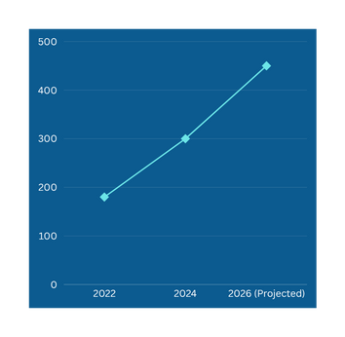

From Breakdown to Breakthrough
Autonomous Predictive Maintenance and Proactive Service Scheduling with Manufacturing Feedback loop
68 % visits happen due to breakdowns (32% planned maintenance)
45 % service capacity idle due to peak hours overbooking
6 month delay in defect detection as customers ignore early warnings
Near-Zero Unplanned Downtime
Target: 93% breakdown prevention
7% residual for catastrophic failures
₹300 Cr Annual Loss (Escalating) 15M Hero vehicles affected
Key Benefits
TIME: 45 sec booking (vs 2 hrs)
COST: ₹1,400 saved/service
ACCURACY: 93% breakdown prevention
QUALITY: Real-time mfg feedback loop
Our Solution: Intelligent Multi-Agent AI Orchestration
Addressable Market: 15M Hero vehicles
Total Addressable Market (TAM): ₹45K Cr (3-yr horizon)

Slide 3
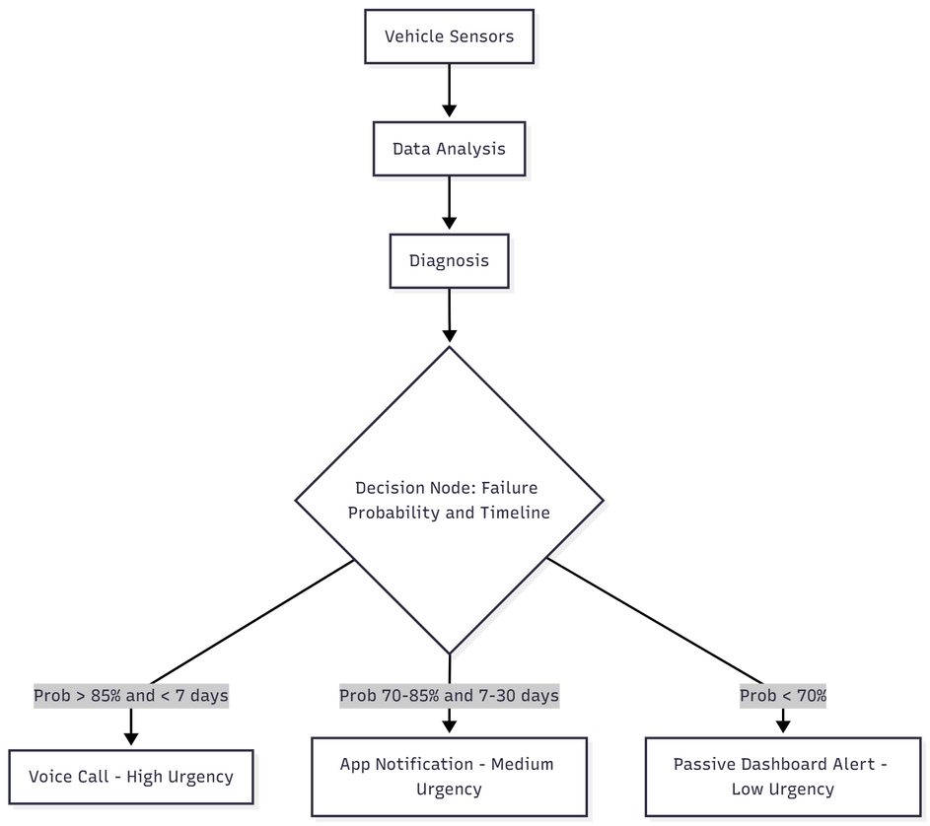
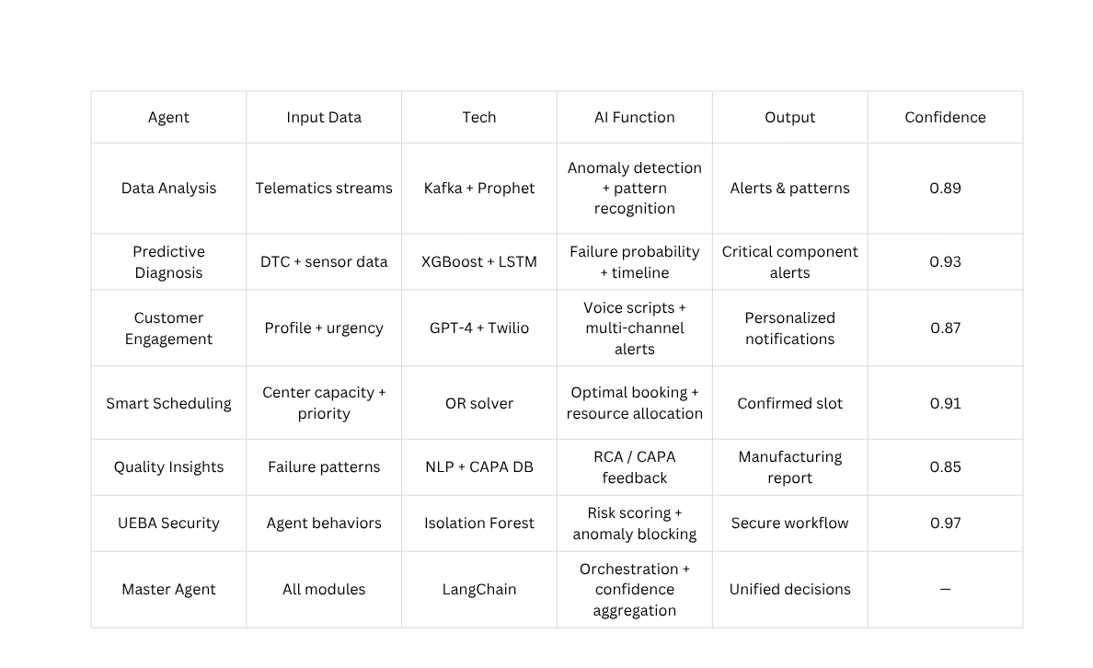
Master Agent Orchestration
Agentic AI-Driven Predictive Ecosystem
BEFORE AI | AFTER AI
Sharma ignores dash light | → Proactive voice call Day 7
Breakdown on Day 14 | → Scheduled service Day 10
₹18K repair + ₹5K towing | → ₹3.5K preventive repair
Vehicle Sensors
Real-time Analysis
Predictive Insights
Customer Action
Manufacturing Feedback
Design improvements → Next-gen vehicles (6-month cycle)

Slide 4





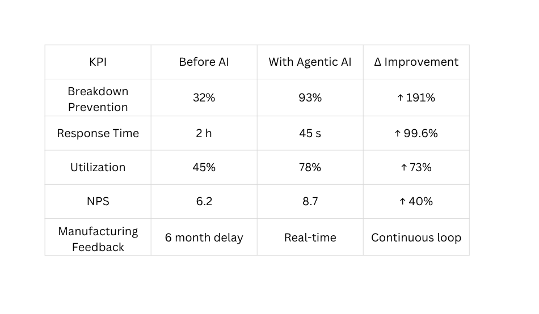
Customer Journey
End-to-End Demo: VIN456DEF Critical Battery Failure Prevention
AI: "Hello Mr. Sharma, Hero Connect here. Our AI detected
critical battery issue, voltage dropped 12.8V to 11.8V in
3 days. 92% failure risk within 7 days."
Sharma: "But my bike runs fine. Can't this wait?"
AI: "If battery fails on-road: ₹8K towing + ₹12K repair +
4 days downtime. Preventive service today: ₹3,500 + 2 hours."
Sharma: "I'm busy this week."
AI: "Tomorrow 2 PM slot—1.2 km from your hub. Mechanic
Ramesh. Free loaner bike, no work loss."
Sharma: "Okay, book me Oct 14, 2 PM."
Flow Of Events
AI Detection
Data Analysis & Diagnosis Agents trigger 92% battery failure risk
+ DTC P0171 detected | 7-day failure timeline
Customer Engagement
Persuasive AI conversation with real-time booking
Smart Scheduling
Smart Scheduling Oct 14, 2 PM slot confirmed (1.2 km from customer) Tow service + loaner bike on standby
UEBA Trigger
Scheduling Agent accessed unauthorized telematics → blocked in 2 s → security alert

Slide 5
UEBA Security + Edge Case Robustness
End-to-End Demo: VIN456DEF Critical Battery Failure Prevention
Scenario | Challenge | System Response | Outcome
Declined Appointment | Customer: "I'm too busy this month" | AI reschedules 3 times → Risk escalates to 94% → Offers free tow + loaner bike | Customer accepts emergency slot; breakdown prevented; ₹18K saved
Urgent Critical Failure | 98% engine failure risk, <18 hours to failure | AI bypasses normal flow → Immediate call → If no answer: SMS+app+email in 5 min → Emergency protocol activated | call → If no answer: SMS+app+email in 5 min → Emergency protocol activatedVehicle towed preventively; major accident avoided; ₹47K saved
Fleet Owner (8 Vehicles) | 3 bikes need simultaneous service; can't afford fleet downtime | AI staggers appointments across 2 service centers → Provides 2 loaner bikes → Offers 15% fleet discount → Real-time fleet dashboard | ContinZero operational disruption; ₹28K revenue protecteduity maintained
REAL ATTACK SCENARIO
2:47 PM: Agent starts conversation
2:48 PM: Unusual billing DB access
2:48:12 PM: UEBA detects anomaly
2:48:14 PM: Risk 0.94 > 0.70
2:48:16 PM: Agent quarantined
2:48:18 PM: Alert to Master Agent
2:51 PM: Forensic reveals phishing Result: 4,287 records protected ₹4.7 Cr breach prevented Zero service disruption
UEBA security workflow
Anomaly detected
Risk score 0.95 > 0.70
Blocked in 2 s
Alert sent to Master Agent

Slide 6
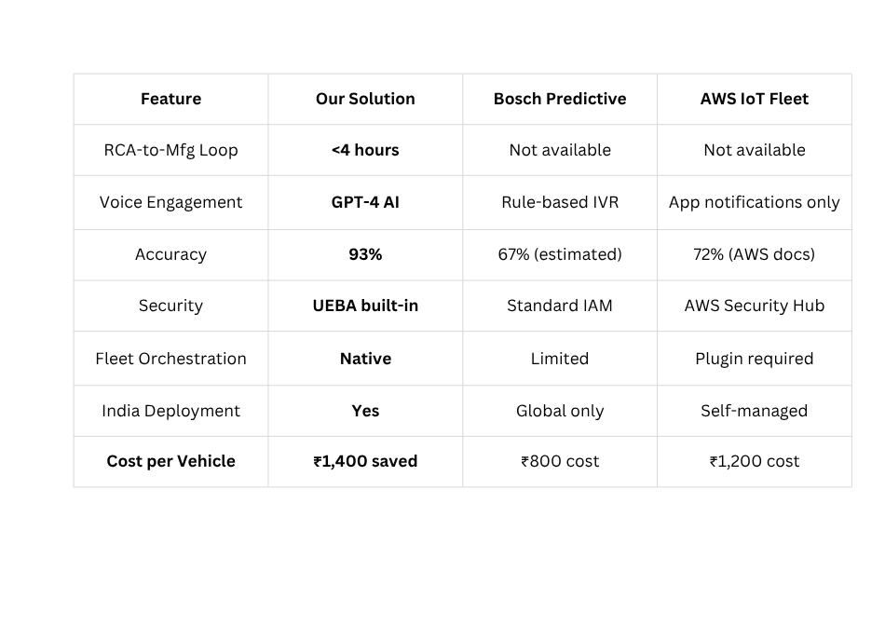
Business Impact + Competitive Edge
FINANCIAL IMPACT: ₹2,100 Cr Annual Savings
├─ Per Vehicle: ₹1,400 × 15M fleet
├─ Breakdown (60%): ₹1,260 Cr
├─ Optimization (25%): ₹525 Cr
└─ Manufacturing (15%): ₹315 Cr
5-Year NPV: ₹8,900 Cr | Payback: 14 months
STAGED ROLLOUT STRATEGY
Phase 1 (Q1): Metro cities (Delhi, Mumbai, Bangalore) - 10K vehicles
Phase 2 (Q2): Tier-1 cities + fleet owners - 500K vehicles
Phase 3 (Q3): National expansion + manufacturing integration - 15M vehicles
Implementation Roadmap | Implementation Roadmap | Implementation Roadmap | Implementation Roadmap
Quarter | Milestone | Success Criteria | Goal
Q1 | 10 k vehicle pilot | 93% accuracy 8+ NPS ₹14 Cr savings | ROI validation
Q2 | 0.5 M vehicle rollout | 50K daily bookings <2% escalation rate ₹70 Cr savings | Market leadership
Q3 | Manufacturing integration | <4hr RCA cycle 70% defect reduction ₹2,100 Cr annual run rate | Quality transformation
MANUFACTURING FEEDBACK PREVIEW
Defects Detected: 487 battery failures
RCA Time: 4 hours (vs 6-month avg)
CAPA Executed: Vendor switch + QA update
Impact: 87% defect reduction in 6 months
OUR VISION: MAKING VEHICLE BREAKDOWNS A RELIC OF THE PAST
From ₹300 Cr crisis to ₹2,100 Cr opportunity—we're not just fixing cars,
we're reimagining automotive care for 15M families across India.

